Slide 1
Yelp Rating System
XiuXiang Jin
YuHao Liu
Ammar Karim
Zeqiang Lin

Slide 2
Overall Design Plan and Changes
main app: from desktop api to web-based flask
Analyze data from api to K mean
Allow user input
Display output in ranking and graphs

Slide 3
Data Collections
Scraping
optimization

Slide 4
Backend (Data Analysis)
Two Parts: Getting Score and Getting Aspect
Part of Speech
Getting Score though NLP
Grab positive and negative words
Check the word before it (degree of adverbs)
Inverted words

Slide 5
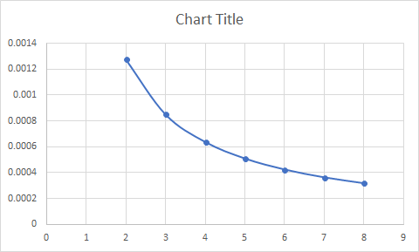
Kmeans
Using reviews of 31 restaurants as training data
Total 6k samples
K = 6 as best
Total length of Feature vector = 20k

Slide 6
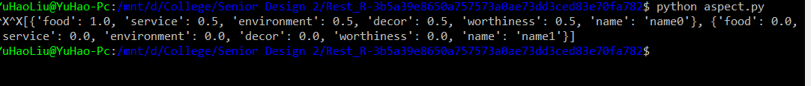
First Calculation
Manual Find the related words of feature words
Calculate the average of ratios of difference of related words between center and data point
Calculate the average of ratios with all reviews as threshold
Sum up and take average of rest of data
Sample Input {“i am good”, “I hate the food”} {“I am good”, “I love the food”}

Slide 7
Second Calculation
Manual Find the related words of feature words
Find the mean of each aspect of all centers
Calculate the average of ratios of difference of related words between center and data point
Split them into corresponding groups based on centers, and within the group calculate the average
Multiply to corresponding average of center, this is threshold
Sum and take average of data point which passed the threshold

Slide 8
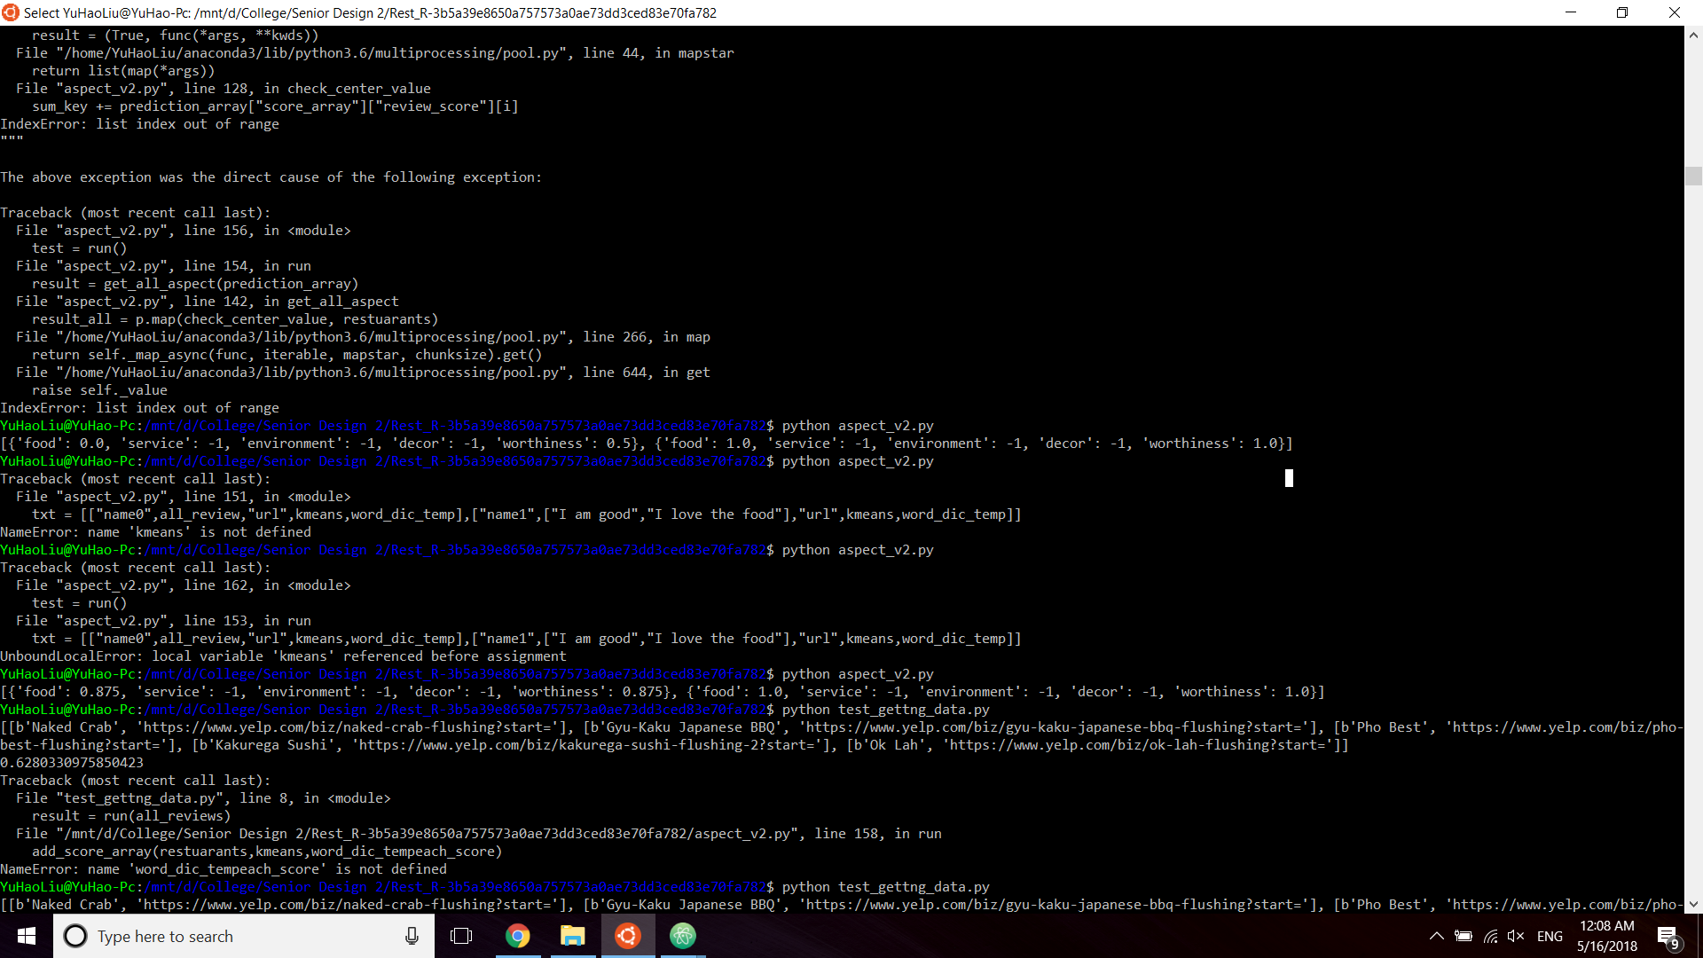

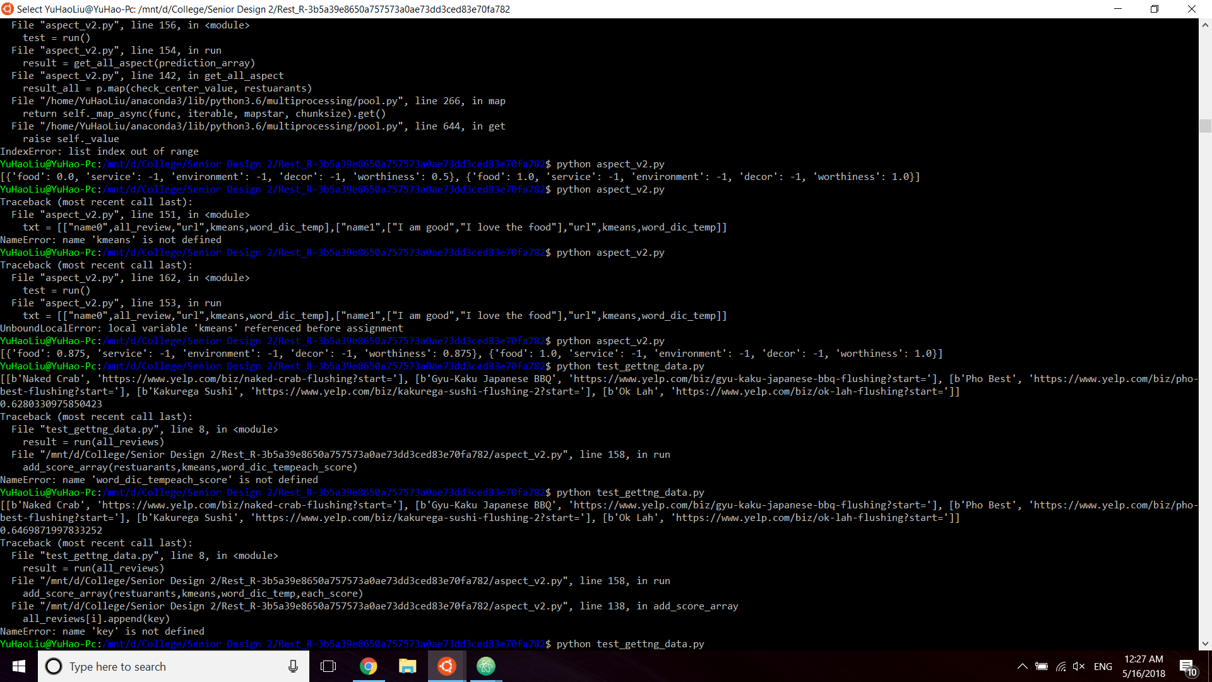
Result

Slide 9
Reason
The possible reasons/causes
wrong calculation method
minor error on the code
size of related words of each aspect is not long enough.

Slide 10
Frontend
Homepage
Rank page for basic restaurant info
Restaurant page and score distribution

Slide 11
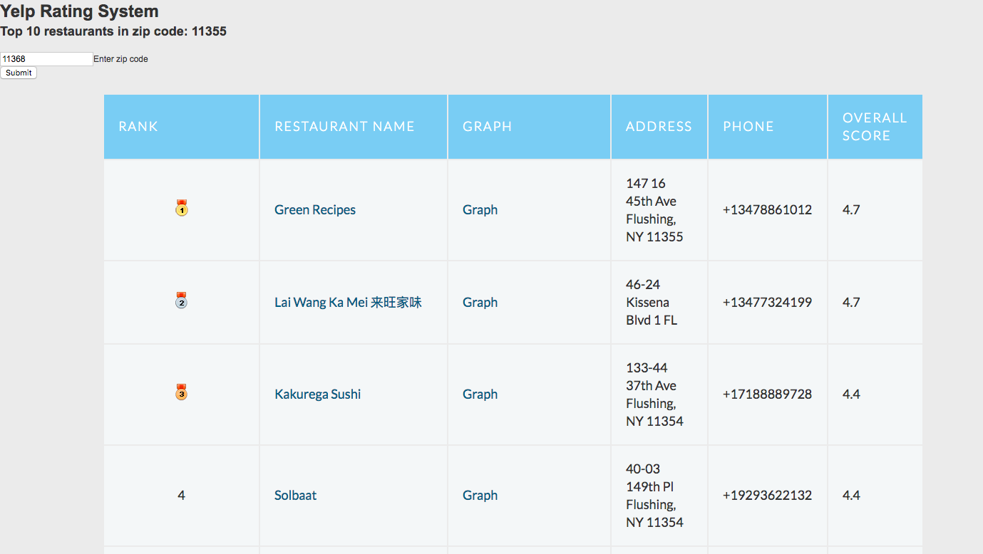
Demo

Slide 12
Conclusion
Some technique issues have not being solved
Biggest Problems: Time Complexity and fix the calculation
The things we can try in future:
Other unsupervised machine learnings
Another way of calculation
Special method/algorithm for big data

